Slide 1

CSC384 TUT9101

Slide 2
CSC384:Intro to artificial intelligence
TUT9101 Thursdays 9:10-10AM

Slide 3
CSC384 Tutorial 3: Heuristics
A1 office hours
Exercise 1 breakout group
Discuss solution
Ex 2 breakout group
Discuss
Exercise 3 breakout group
Discuss
Questions?
Toso vote

Slide 4
A1 office hours
Thursday, February 4, 2020
6:00 Pm - 7:00 Pm EST
On "BB Collaborate"
hosted by Daniel Razavi.

Slide 5
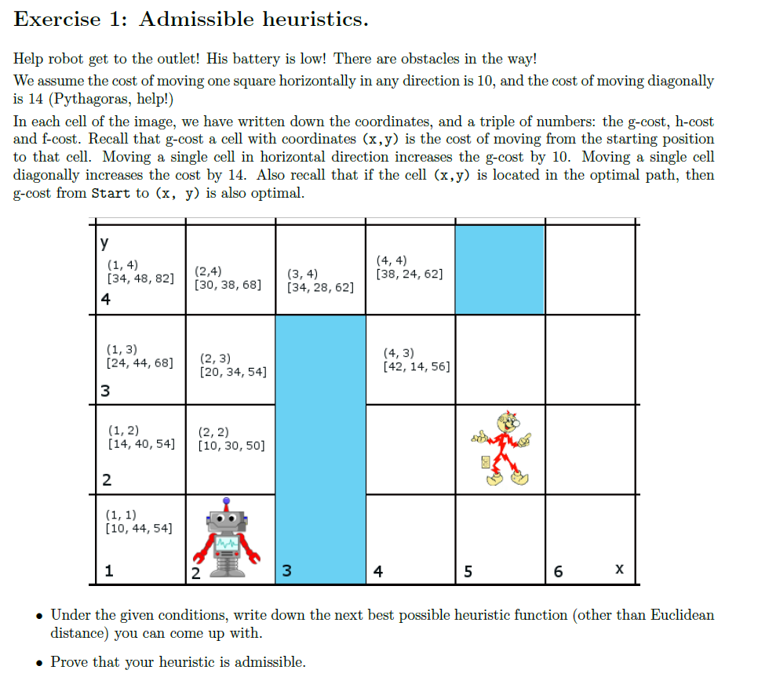

Slide 6
Reminder: Admissibility
h(n) ≤ h∗(n) means we won’t miss any promising paths.
• If it is really cheap to get to a goal via n (i.e both g(n) and h∗(n) are low), then f(n) = g(n) +h(n) will also be low, and the search won’t ignore n in favour of more expensive options. optimality.
• This can be formalized to show that admissibility implies optimality.

Slide 7
A solution:
Let A = (x_{A}; y_{A}) and B = (x_{B}; y_{B})
(goal node): dx = ㅣx_{A} - x_{B}ㅣ; dy =ㅣy_{A} - y_{B}ㅣ
Then h(A) = 14min(dx,dy) + 10ㅣdx - dyㅣ is the required function.
To see why, draw a simple sketch and consider two cases:
min(dx, dy) = dx, and min(dx, dy) = dy.

Slide 8
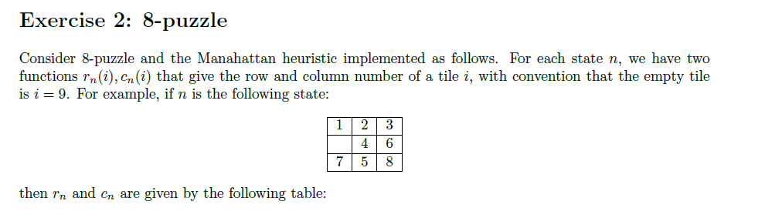
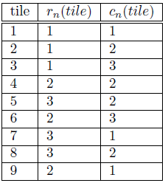
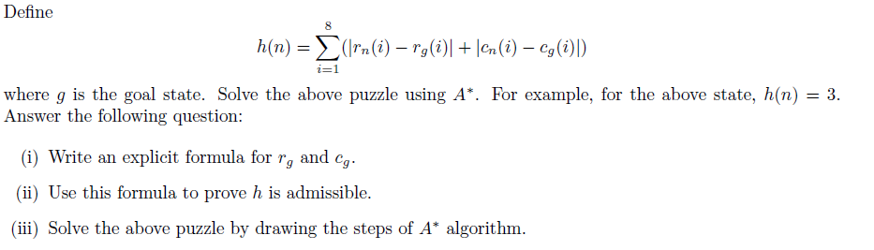
3

Slide 9
Ex2 solution
r_{g}(i) = div(i-1,3)+1, c_{g}(i) = [(i-1)mod3]+1
If we look at the equations above and h we can see that each move will only change h by 1 which is same cost.
Kristina will attempt to use whiteboard feature on bbcollab….

Slide 10
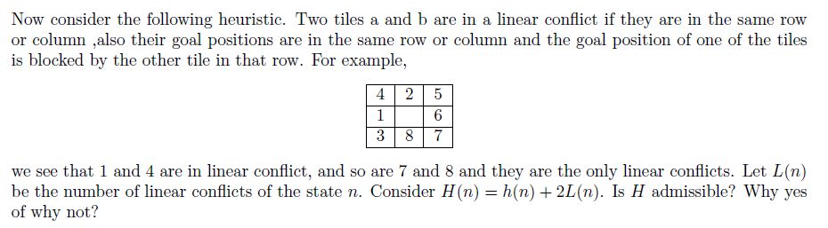
Exercise 2 second part

Slide 11
Ex 2 pt 2 Solution
One linear conflict causes two moves to be added to the final heuristic value(h) as one tile will have to move aside in order to make way for the tile that has the goal state behind the moved tile and then back resulting in 2 moves. Therefore ADMISSIBLE!

Slide 12
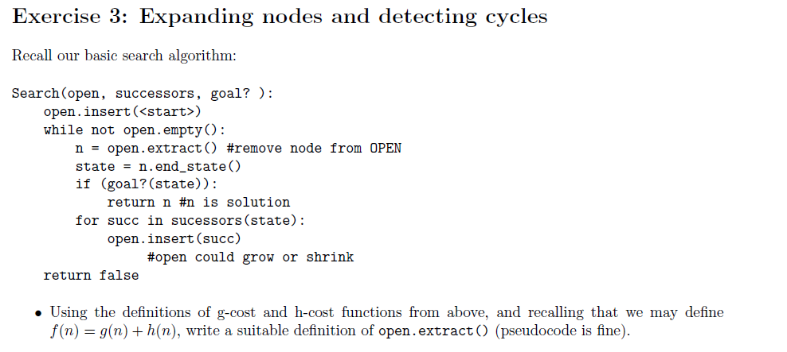
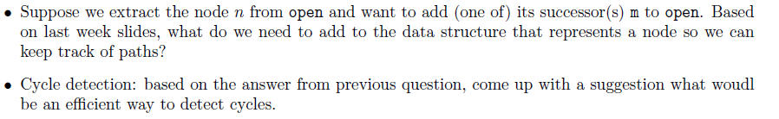

Slide 13
Exercise 3 open.extract() definition:
Open is a heap
Heap priority:
n1 has prio over n2 iff f(n1)<f(n2) OR f(n1)=f(n2) and h(n1)<=h(n2)
If n1 and n2 have equal f and h, then choose whichever

Slide 14
Ex3 adding successor to open
Each node has a pointer to parent node

Slide 15
Ex3 cycle detection
Maintain an additional data structure (we may call it closed) where we store nodes that have already been extracted from open.
We can also modify the successor function to avoid nodes in the closed set. This prevents a node from having its parent pointer set to a node previously in the open set.

Slide 16
Any questions?

Slide 17
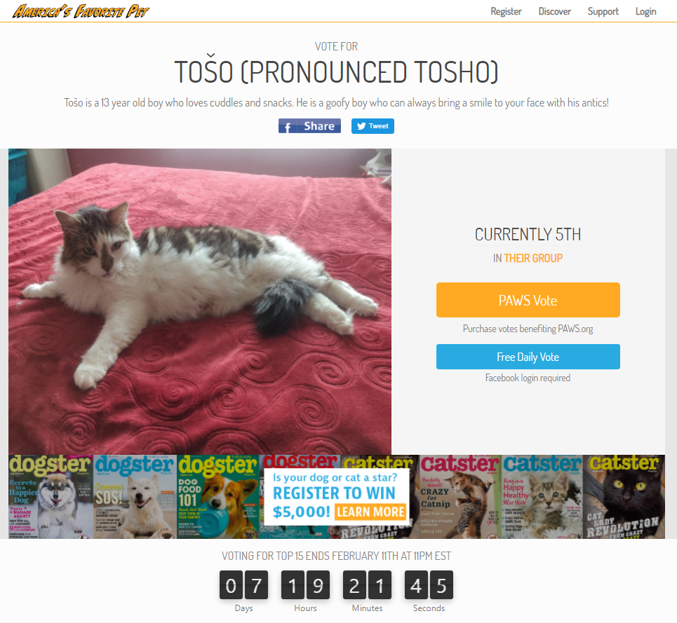
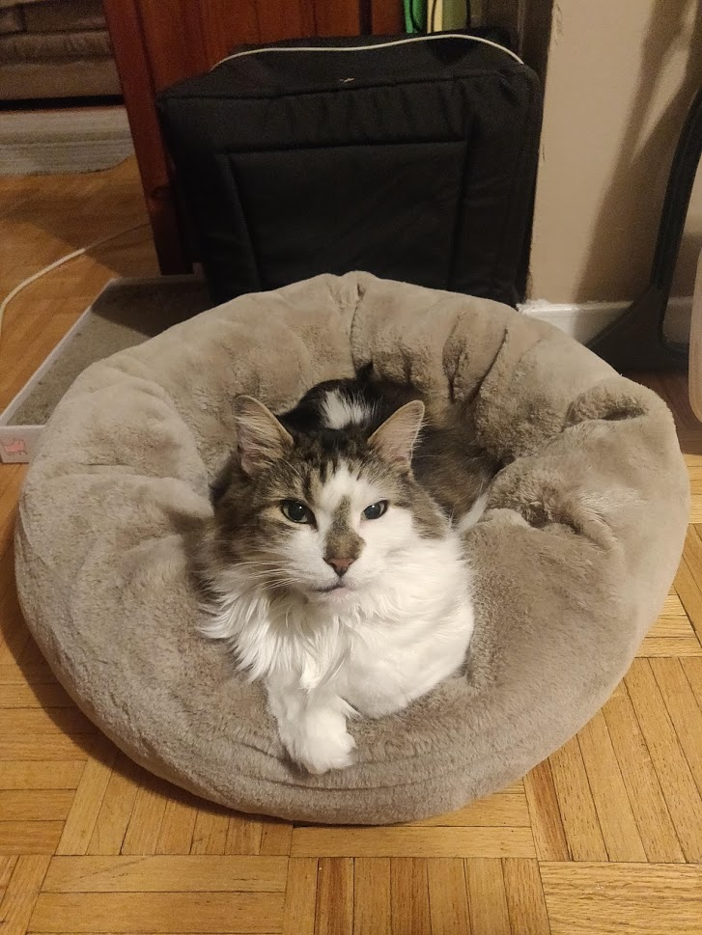
Pls consider voting for Toso for America’s favourite pet!
I will put link in chat if you would like to vote!

